Slide 1
Structure Chart
A structure chart represents the software architecture, i.e. the various modules making up the system, the dependency (which module calls which other modules), and the parameters that are passed among the different modules.
Since the main focus in a structure chart representation is on the module structure of the software and the interactions among different modules.

Slide 2
The basic building blocks which are used to design structure charts are the following:
  • Rectangular boxes: Represents a module.
  • Module invocation arrows: Control is passed from one module to another module in the direction of the connecting arrow.

Slide 3
• Data flow arrows: Arrows are annotated with data name; named data passes from one module to another module in the direction of the arrow.
• Library modules: Represented by a rectangle with double edges.
• Selection: Represented by a diamond symbol.
• Repetition: Represented by a loop around the control flow arrow.

Slide 4
Structure Chart vs. Flow Chart
We are all familiar with the flow chart representation of a program. Flow chart is a convenient technique to represent the flow of control in a program. A structure chart differs from a flow chart in three principal ways:
  • It is usually difficult to identify the different modules of the software from its flow chart representation.
  • Data interchange among different modules is not represented in a flow chart.
  • Sequential ordering of tasks inherent in a flow chart is suppressed in a structure chart.

Slide 5
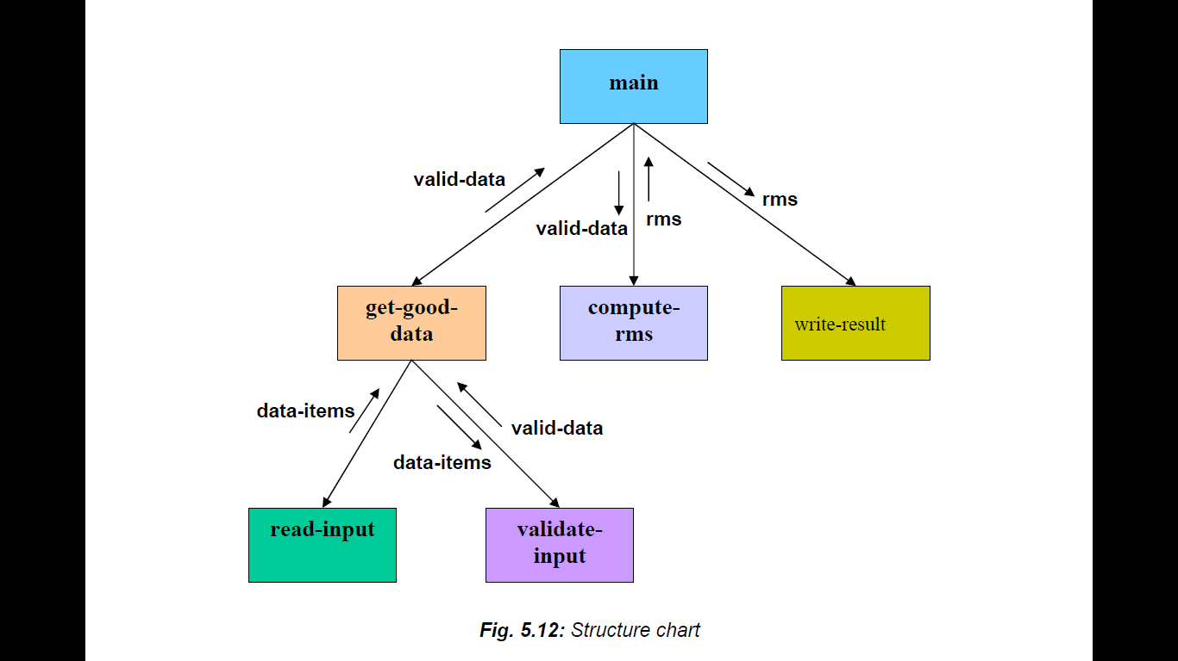
Example: Structure chart for the RMS software

